Slide 1
Giacomo Cappon
Networking

Slide 2
Outline
Recap
The network flow
RESTful API in practce
Case study
Exercise
Homework
Resources

Slide 3

Recap
Lesson 1
Lesson 5
Lesson 8
Lesson 10
Collaborate and version code
Create a layout
Make simple API calls
Implement user authentication
Lesson 2/3
Lesson 6
Lesson 9
Lesson 11
Get familiar with Dart
Navigate between screens
Fetch wearable data
Persist user data
Lesson 4
Lesson 7
Lesson 12
Understand Flutter’s principles
Manage the app state
Advanced stuff
Milestone #1
Milestone #2
Milestone #3
Do something with your fantasy

Slide 4
Outline
Recap
The network flow
RESTful API in practce
Case study
Exercise
Homework
Resources

Slide 5






The network flow
Front-End
Back-End
DB
RESTful API
Messaging service
Server
Heavy computing service

Slide 6
Outline
Recap
The network flow
RESTful API in practce
Case study
Exercise
Homework
Resources

Slide 7
RESTful API in practice
From the practical point of view, RESTful API can be used via http following three steps:
Step 1: Send an http request to the RESTful API
Step 2: Await for the response
Step 3: Process the response (usually in a JSON format)
The http request has the following structure:
<METHOD> <HTTP or HTTPS>://<DOMAIN>/<ENDPOINT>?<PARAMETERS>
+
<BODY> and <HEADERS>
<METHOD> and <ENDPOINT> defines the so-called route, e.g.:
GET /heartrate/today/
DELETE /user/1

Slide 8
RESTful API in practice
Beside its content a response contains an HTTP status code, i.e., a special number that tells to the frond-end if the request is successful or, otherwise, why it is not successful. Here’s the most common:
200: OK
401: UNAUTHORIZED
403: FORBIDDEN
404: NOT FOUND
500: INTERNAL SERVER ERROR
Normally, the front-end developer has to manage these codes based on the API specifics

Slide 9
Outline
Recap
The network flow
RESTful API in practce
Case study
Exercise
Homework
Resources

Slide 10
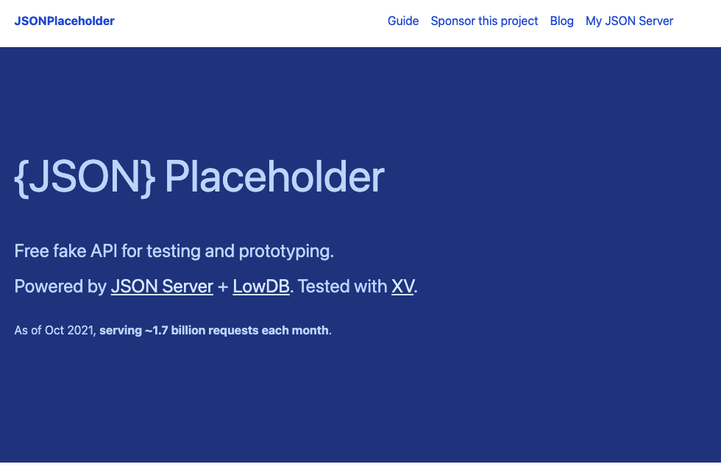
{JSON} Placeholder
To learn how to do request to an API and process its result we will use {JSON}Placeholder

Slide 11
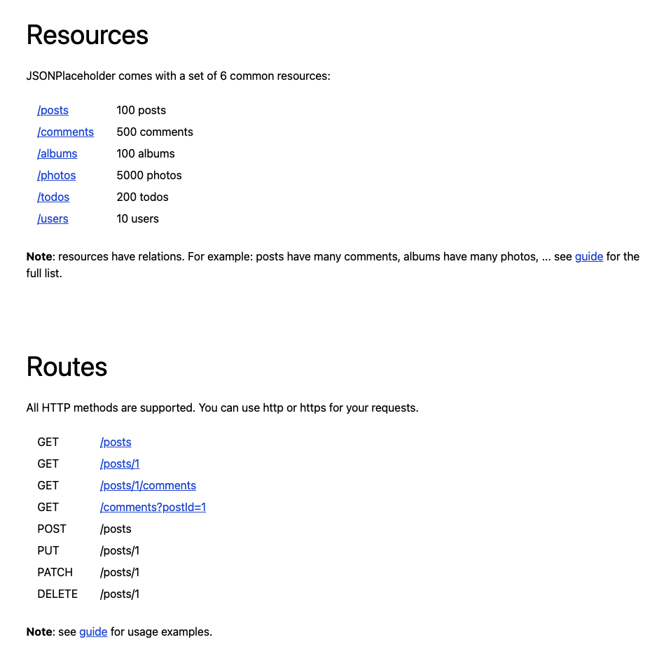
{JSON} Placeholder
{JSON}Placeholder exposes the following resources and routes we can play with

Slide 12
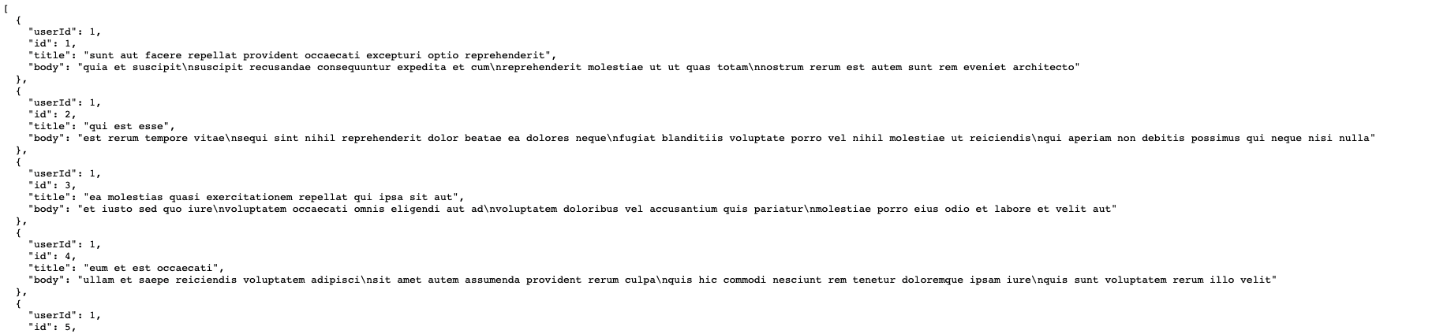
{JSON} Placeholder – Post resource
Let’s zoom in the post resource:
https://jsonplaceholder.typicode.com/posts (this is equivalent to the GET https://jsonplaceholder.typicode.com/posts request) will result to:
So, we have a list of posts, each identified via an id, the id of the user who posted it, a title, and a body.

Slide 13
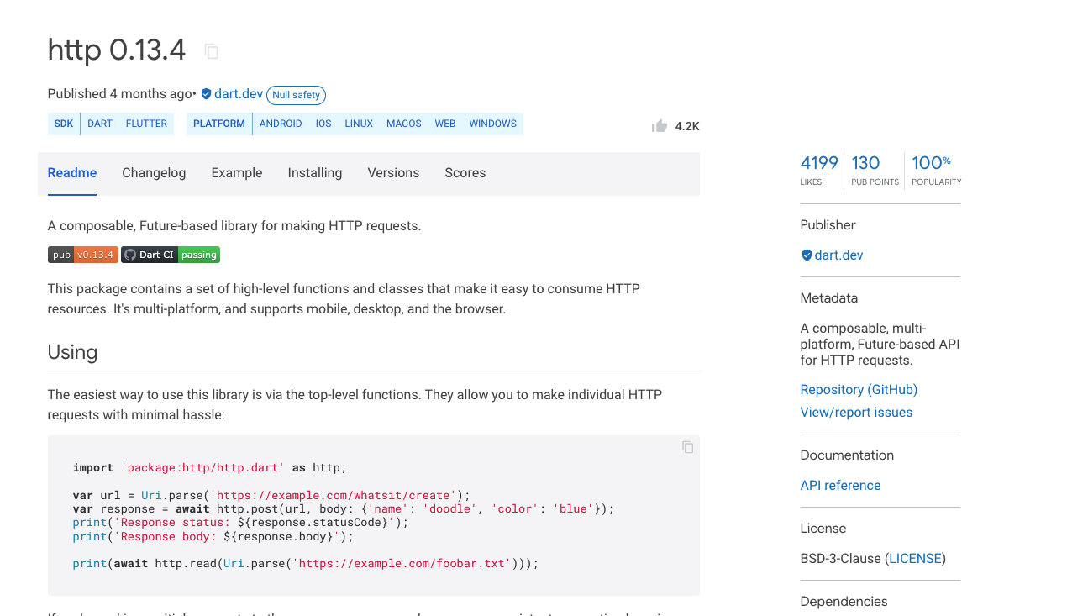
http package
To be able to make calls we will use the http package. This provides a simple web client to be used to make http calls.

Slide 14
Android-specific action
To be able to access to internet functionalities in Android you are required to provide a specific permission:
To do so, in the android>app>src>main folder open the AndroidManifest.xml file, and add the following after the <manifest …> tag:
<uses-permission android:name="android.permission.INTERNET" />
No need to do this in iOS.

Slide 15

Case of study - Live
To demonstrate how to make and process API calls in Flutter, we will build a very simple app called ”network_master” able to
Fetch data of a specific post from {JSON}Placeholder → GET method
Create a new post in {JSON}Placeholder → POST method
Full example in lab_08-networking/network_master/
Notes:
Step 0: Add internet permission to Android
Step 1: Structure of the app → HomePage only
Step 2: Create the Post model
Step 3: Create the HomePage UI
Step 4: Create the method to fetch data
Step 5: Create the method to post data

Slide 16
Outline
Recap
The network flow
RESTful API in practce
Case study
Exercise
Homework
Resources

Slide 17

Exercise
Exercise 08.01
Implement a Pokédex
The user can search into the search bar for a Pokémon given its number (be aware that valid numbers go from 1 to 898). Once the button is tapped, if the number is valid, some of the Pokémon details are shown to the user.
The user can add that Pokémon to its favorites using a button.
Via a button in the AppBar, the user navigates to another screen where all its favorite Pokémon are shown.
In the “Favorites Pokémon page” the user can look at the list and delete entries.

Slide 18
Outline
Recap
The network flow
RESTful API in practce
Case study
Exercise
Homework
Resources

Slide 19
Homework
Get familiar with the http package
Take a look to a powerful alternative to the http package: Dio
https://pub.dev/packages/dio

Slide 20
Outline
Recap
The network flow
RESTful API in practce
Case study
Exercise
Homework
Resources

Slide 21
Resources
HTTP Status Codes
https://en.wikipedia.org/wiki/List_of_HTTP_status_codes
{JSON}placeholder APIs
https://jsonplaceholder.typicode.com/
PokéAPI
https://pokeapi.co/
Fetch data from the internet. Cookbook by the Flutter community
https://docs.flutter.dev/cookbook/networking/fetch-data
Send data to the internet. Cookbook by the Flutter community
https://docs.flutter.dev/cookbook/networking/send-data

